Slide 1
App Store
Group Members:
Muhammad Sarim Sheikh (02-131222-075)
Abdul Wahab Aslam (02-131222-132)
Abdullah (02-131222-099)

Slide 2

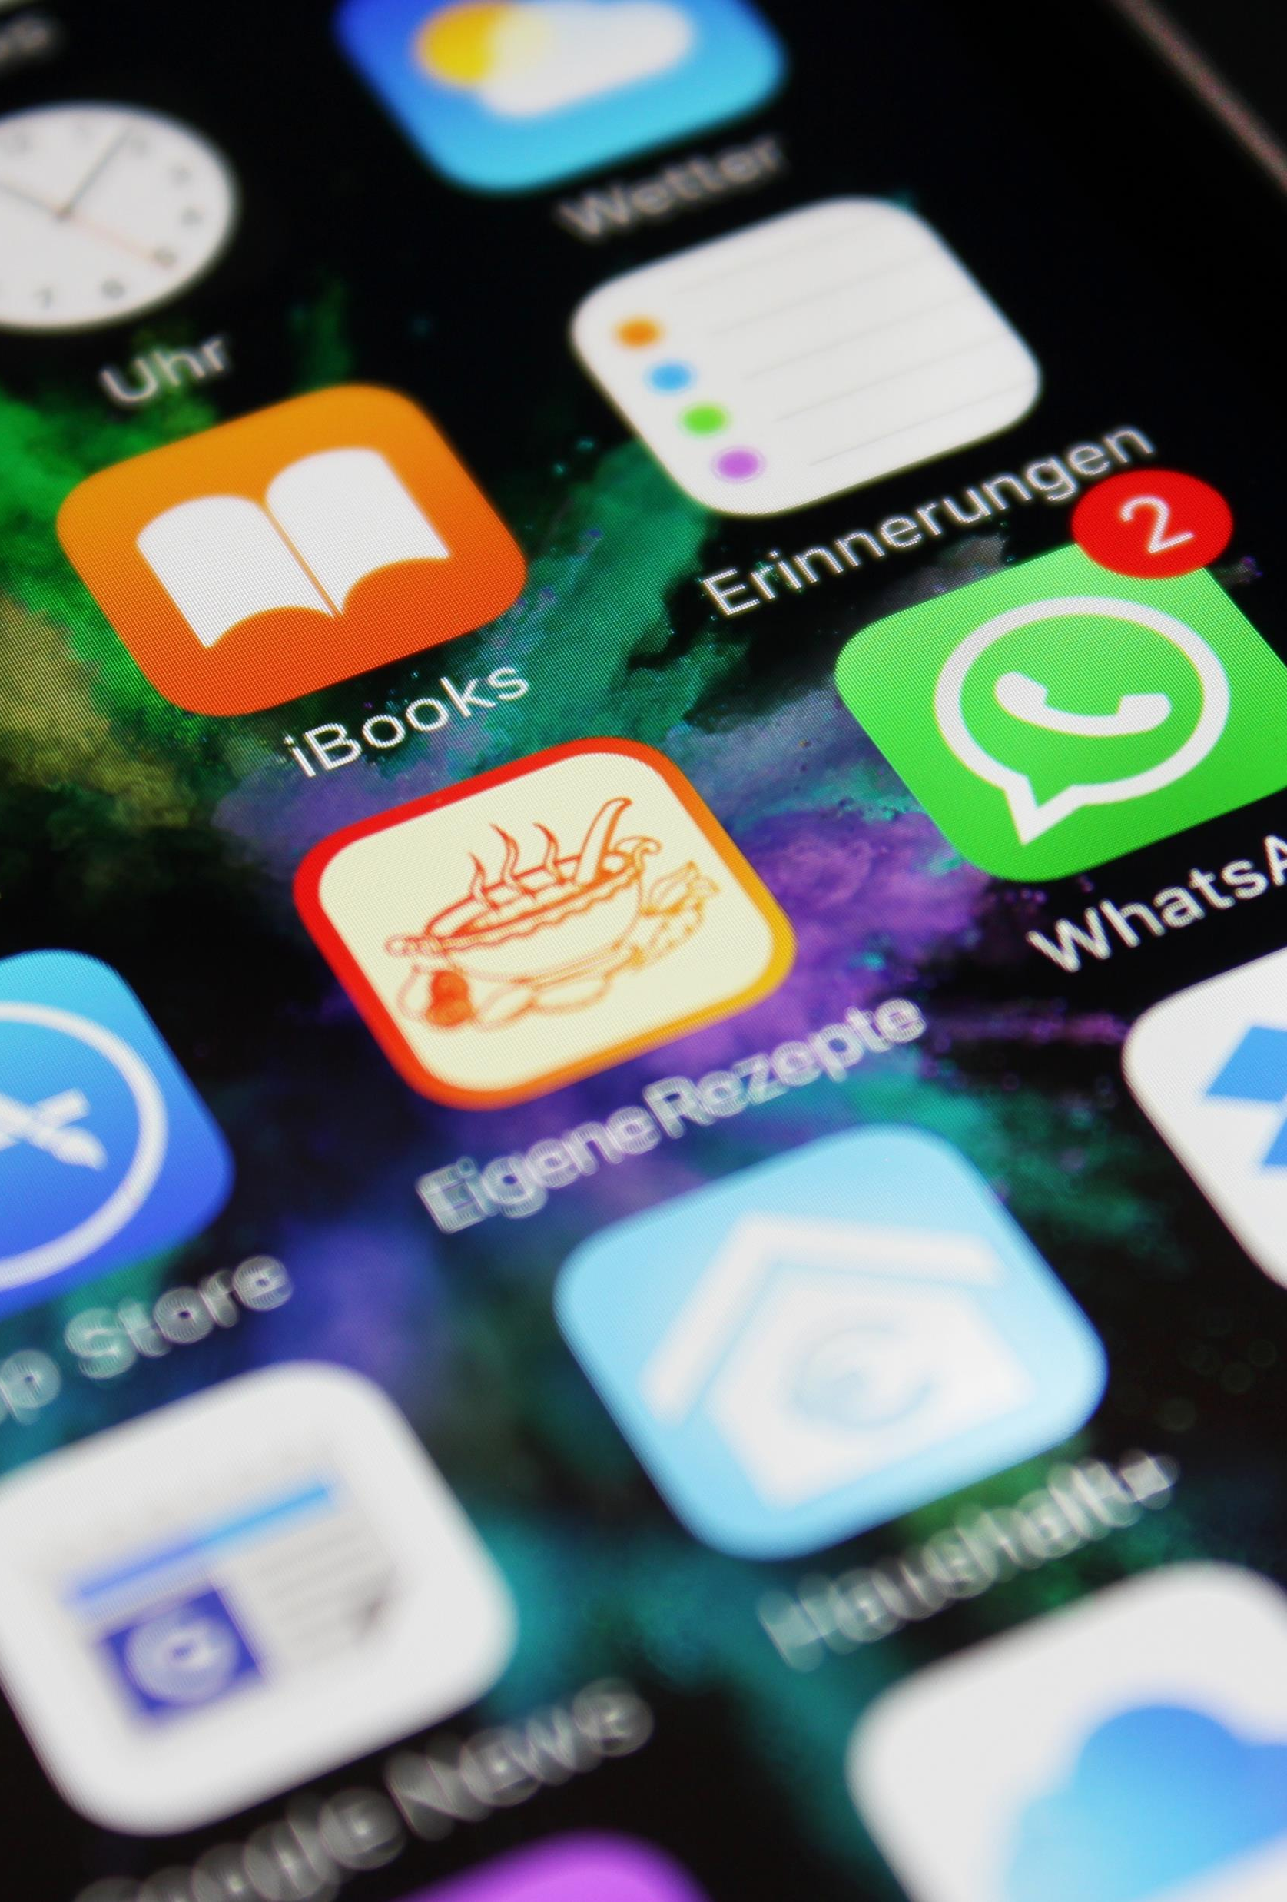
What is an App Store?
An app store is an application that helps a user find software and install it on their computer or mobile device. It's a collection of free or commercial software and games approved for use on your device. You can browse, purchase, download, install, and update software through your device's app store.

Slide 3
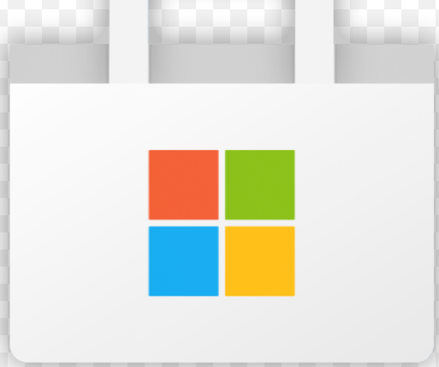
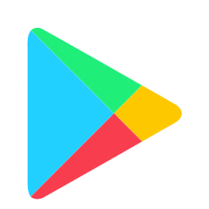
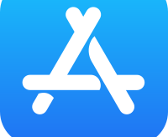
Types Of App Stores
Apple App Store
Google Play Store
Microsoft App Store
This Photo by Unknown Author is licensed under CC BY-SA

Slide 4

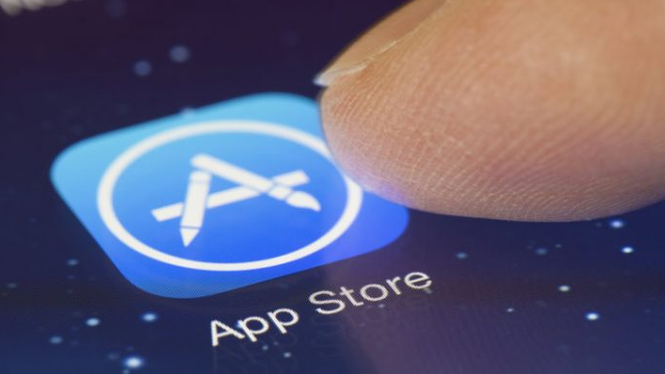

APPLE APP STORE
This Photo by Unknown Author is licensed under CC BY-NC

Slide 5
Apple App Store
The App Store is an app store platform, developed and maintained by Apple Inc., for mobile apps on its iOS and iPad OS operating systems. The store allows users to browse and download approved apps developed within Apple's iOS Software Development Kit. Apps can be downloaded on the iPhone, iPod Touch, or iPad, and some can be transferred to the Apple Watch smartwatch or 4th-generation or newer Apple TVs as extensions of iPhone apps.

Slide 6

HISTORY:
The App Store was opened on July 10, 2008, with an initial 500 applications available. As of 2021, the store features more than 1.8 million apps.
Apple’s App Store is a big business for the company. In 2019, Apple's App Store had gross sales of around $50 billion.

Slide 7

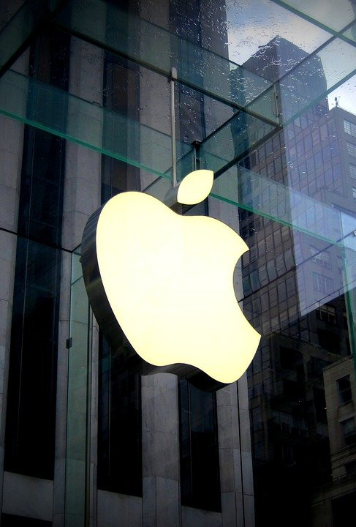
Importance of App Store
Apple app store is not just an app store, but a paradise for mobile users. As the world’s leading software company, Apple is always HUGE on user experience, no doubt. Therefore, it even has the most awesome app store for its consumers. Apple app store is a digital distribution platform for Apple users to explore iOS and iPad apps. With it, smartphone users get assurance of downloading trustworthy iOS powered apps from verified mobile development businesses worldwide.
This Photo by Unknown Author is licensed under CC BY-ND

Slide 8

How Can Developers Publish an App:
App publishers must submit their app to a testing process, adhere to Apple's rules and guidelines, and meet a number of prerequisites. Some prerequisites include:
Developers must pay a $99 annual fee to access the Apple Developer Program. (This fee is waived for nonprofits and governments.)
Getting an App ID or application identifier for your app.
This Photo by Unknown Author is licensed under CC BY-SA

Slide 9
Cont..
Creating an iOS provisioning profile to distribute an app via the App Store.
Obtaining a distribution certificate, which enables an app developer to create a provisioning profile.
Setting a deployment target (important to get this right the first time).

Slide 10
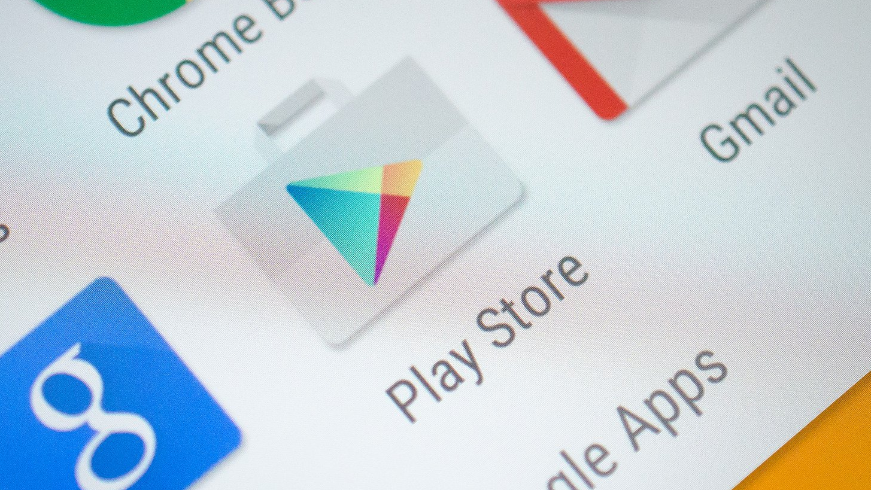
GOOGLE PLAY STORE
This Photo by Unknown Author is licensed under CC BY-ND

Slide 11
GOOGLE PLAY STORE:
Google Play Store is a digital distribution service operated and developed by Google. It serves as the official app store for certified devices running on the Android operating system and its derivatives, as well as Chrome OS, allowing users to browse and download applications developed with the Android software development kit (SDK) and published through Google.

Slide 12
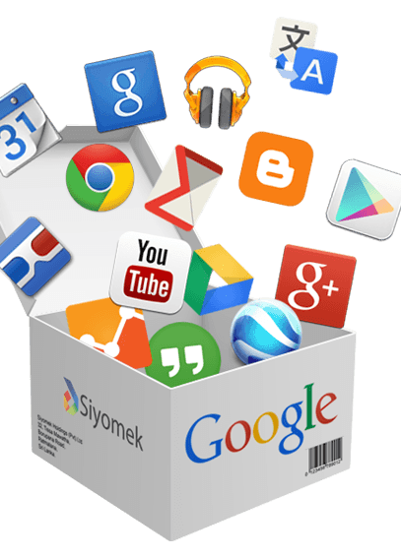
Google Play Store, shortened to Play Store on the Home screen and App screen, is Google's official pre-installed app store on Android-certified devices. It provides access to content on Google Play, including apps, books, magazines, music, movies, and television programs.
This Photo by Unknown Author is licensed under CC BY-NC

Slide 13
History:
28 Aug. 2008
Android Market was announced by Google on August 28, 2008. It was made available to users on October 22, 2008.
2009
In 2009, paid applications were introduced in February for developers in both the United States and England.
Sep. 2010
In September of 2010, the support for applications for the Android Market expanded across 29 countries worldwide.

Slide 14
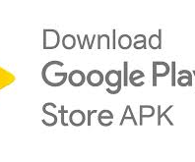
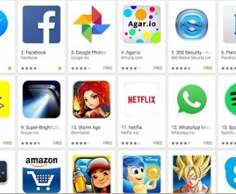
Cont…
In March 2012, the Android Market was rebranded as Google Play and in May 2012, Google introduced in-app subscriptions to Google Play.
In April 2016, Google introduced a redesign of play applications. The new icons were similar to the old icons, but the primary goal was to provide a consistent look across all devices.

Slide 15
How Google play store works?
Google Play is an online store where people go to find their favourite apps, games, movies, TV shows, books, and more. It provides 2 million apps & games to billions of people around the world.
One can install apps, games, and digital content on one’s device from the Google Play Store. Some content is available at no charge, and some you need to buy.

Slide 16
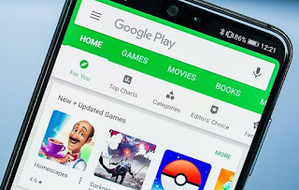
Benefits of google play store?
Some advantages and disadvantages are:
It is quite user friendly.
One can easily download an install apps of appropriate size.
It warns you about potentially harmful apps.
One can uninstall unnecessary app.
It sends privacy alerts about apps that can get user permissions to access personal information, violating our developer policy.
It may reset app permissions to protect your privacy on certain Android versions.
This Photo by Unknown Author is licensed under CC BY-SA-NC

Slide 17
What are the features of Play Store?
Google Play has also served as a digital media store, offering games, music, books, movies, and television programs.
Content that has been purchased on Google Play Movies & TV and Google Play Books can be accessed on a web browser and through the Android and iOS apps.

Slide 18
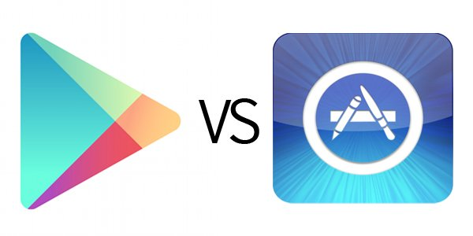
Difference between app store and play store:
Google Play Store is more developer friendly, leading to a substantially larger number of both developers and apps.
There is less risk in choosing to submit an app to Google Play because the approval rate is much higher than on the App Store.
In fact, App Store has recently started to adopt the categorization style of Google Play Store.
For security, App Store is safer as compared to Google Play Store. Because App Store takes considerable time in reviewing any application and then uploading on the main platform then, Google Play Store contains some low-quality apps, and its reviews and uploading process is not as complex as compared to App Store.
This Photo by Unknown Author is licensed under CC BY-SA

Slide 19
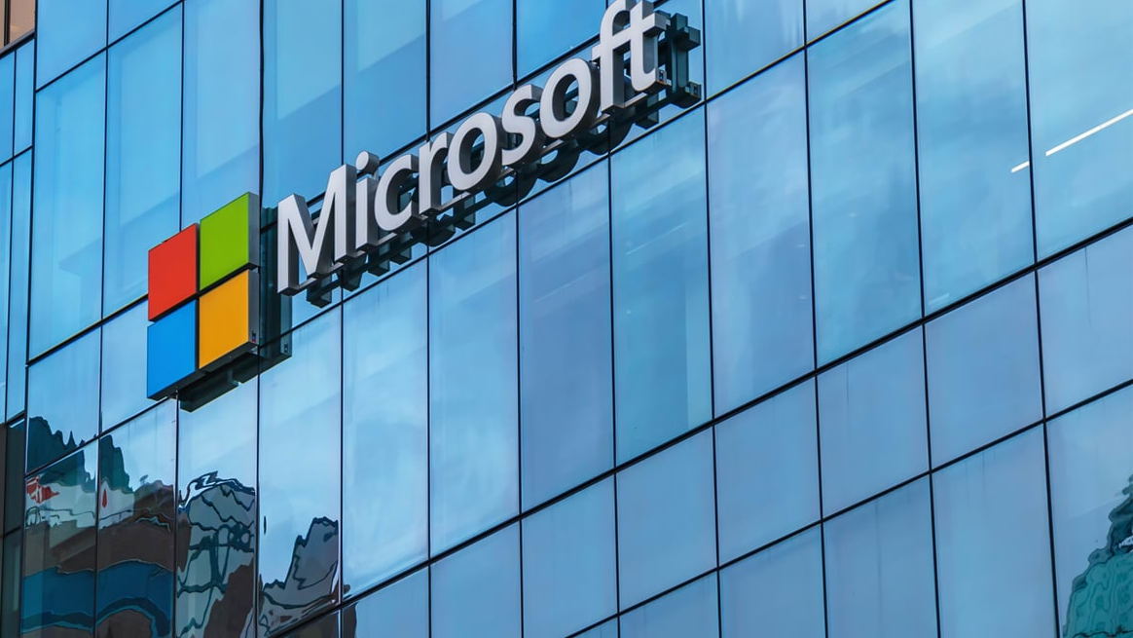
Microsoft App Store
This Photo by Unknown Author is licensed under CC BY-SA-NC

Slide 20
Microsoft App Store
The Microsoft Store formerly called the Windows Store is an online marketplace for consumers to buy and download a variety of items. The store enables users to purchase hardware such as PCs, Surface products and Xbox consoles, or download software and digital content, including apps, games, movies or TV shows.

Slide 21
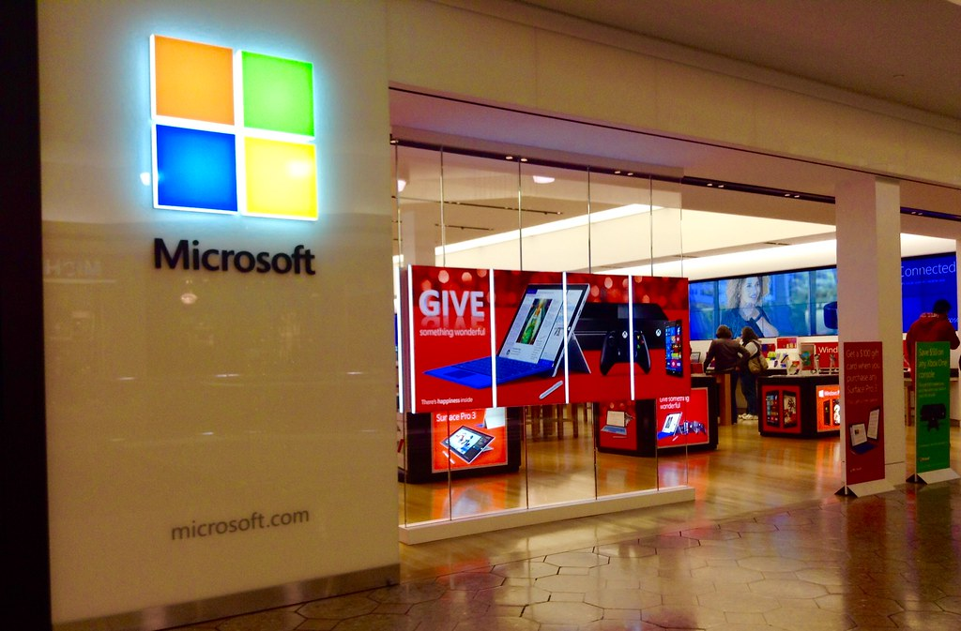
History:
Microsoft announced the Windows Store in September 2011 and opened the marketplace in February 2012. The store offered listings for certified Windows applications and was hosted on Windows 8 and as a web-based storefront. The marketplace could also track product keys and licenses.
This Photo by Unknown Author is licensed under CC BY

Slide 22
Offering of Microsoft app store?
Items from the Microsoft store that users can purchase include the following:
Software:
Microsoft Teams, Outlook and a collection of other applications are available, including Adobe Photoshop, Netflix, iTunes and Spotify.
Business applications:
These include business apps such as Microsoft Cloud, Microsoft 365.

Slide 23
Cont..
Games:
Users can peruse a catalog of games that spans console and mobile platforms, supported by Windows and Xbox systems.
Developer and IT-related tools and applications:
These include tools for Windows Server, Windows Dev Center, HoloLens and .NET applications.

Slide 24

Windows Developer portal:
The store also has a developer portal with which developers can interact. The Windows developer portal has the following sections for each app
App Summary: An overview page of a given app, including a downloads chart, quality chart, financial summary, and a sales chart.
App Adoption: A page that shows adoption of the app, including conversions, referrers, and downloads.
App Ratings: A ratings breakdown, as well as the ability to filter reviews by region.
App Quality: An overview page showcasing exceptions that have occurred in the app.
App Finance: A page where a developer can download all transactions related to their app.
This Photo by Unknown Author is licensed under CC BY-SA

Slide 25
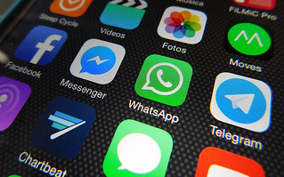
Apps on Microsoft Store:
In the second quarter of 2022, the Microsoft Store (previously known as the Windows Store) hosted and distributed 44,275 gaming apps, making it the largest category of mobile apps on the platform. Utilities and tool apps ranked second, with approximately 10,000 apps hosted and distributed in the Microsoft Store.
This Photo by Unknown Author is licensed under CC BY

Slide 26
Conclusion:
In general an app store (application store) is an online portal through which software programs are made available for users and through this online portal user can download and install application.

Slide 27
Thank You.

